Slide 1
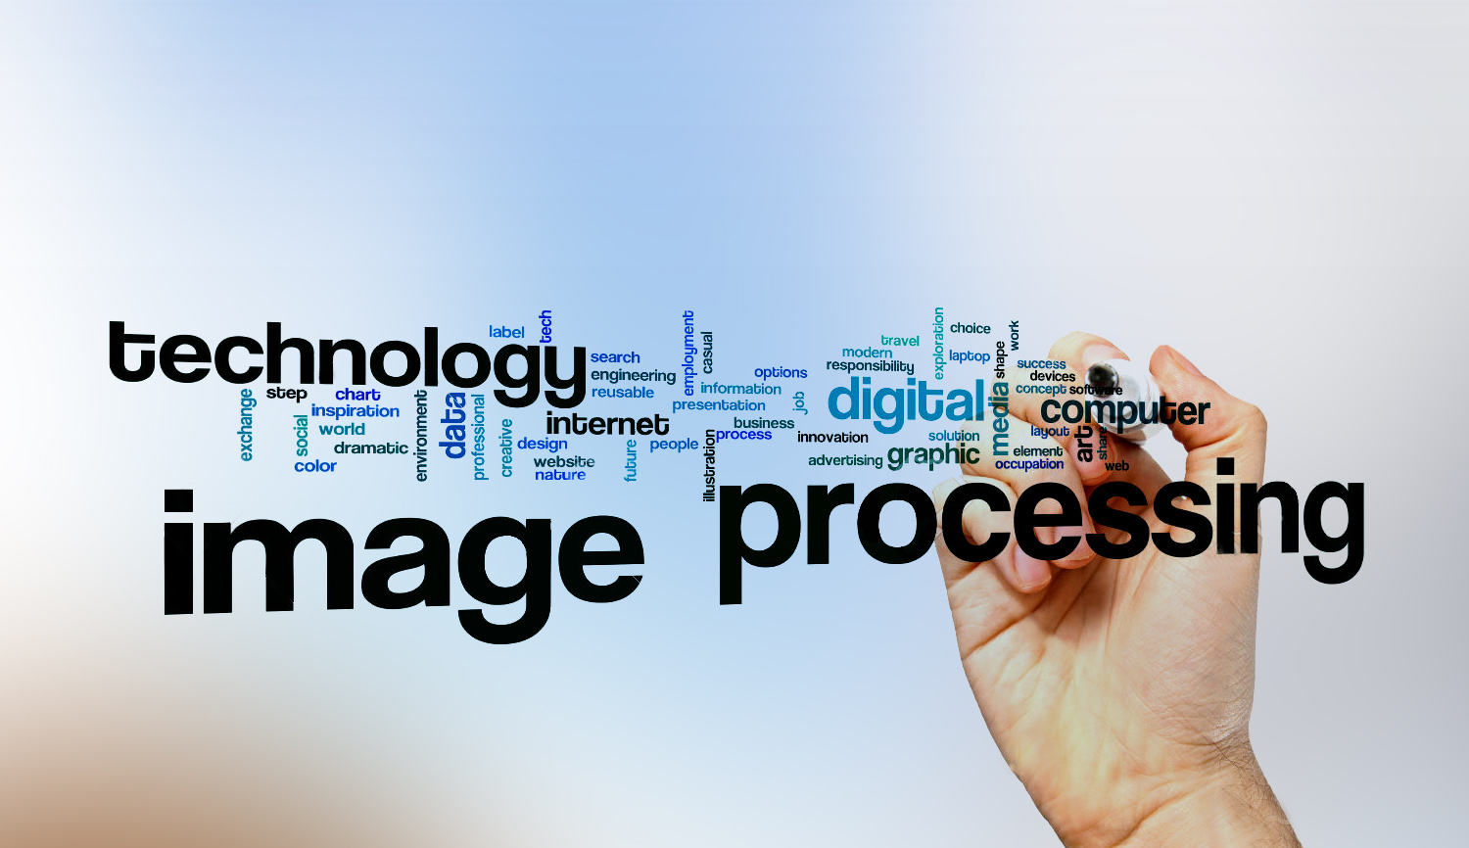
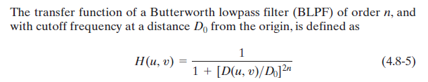
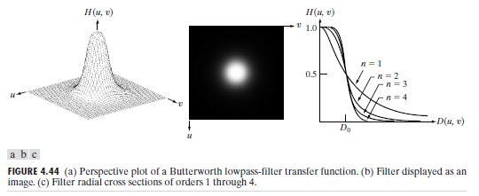
Digital Image Processing
26-Butterworth low pass filter
smoothing methods

Slide 2
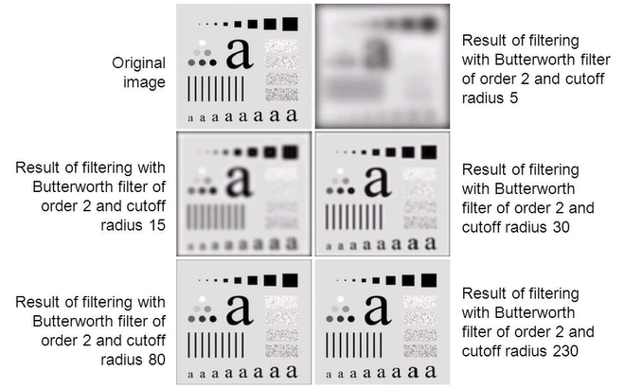
Digital Image Processing
26-Butterworth low pass filter

